Slide 1

Contract Monthly Claim System (CMCS) Improved Academic Claims Management The CMCS offers lecturers, coordinators, managers, and HR personnel a complete solution to effectively handle monthly claims with full communication and real-time tracking by converting traditional academic claims processing into a digital workflow.

Slide 2
Agenda
Project Introduction & Value
Technical Architecture & Code
Database Design & Security
GUI & User Experience
Features
Future Roadmap
Conclusion
The whole CMCS solution is covered in this presentation, including the responsive Bootstrap interface, SQL database design, ASP.NET Core MVC controllers, role-based security, and the business value

Slide 3

Project Introduction & Value Lecturers submit claims online, coordinators approve digitally, managers monitor departments, and HR watches the entire workflow with thorough reporting and analytics dashboards

Slide 4

Overcoming Problems
Manual Processing: Time-consuming paperwork and complex calculations prone to human error
Lack of Transparency: No visibility into claim status causing frustration and uncertainty
Administrative Burden: Coordinators and managers spend excessive time on verification tasks
Delayed Payments: Multi-week processing cycles affect lecturer satisfaction and retention
Value Delivered
Time Reduction: Automated calculations and workflows accelerate processing
Zero Calculation Errors: System validates all inputs and auto-computes totals
Real-Time Tracking: Live status updates and comprehensive dashboards
Cost Savings: Reduced administrative overhead and paper-based expenses

Slide 5
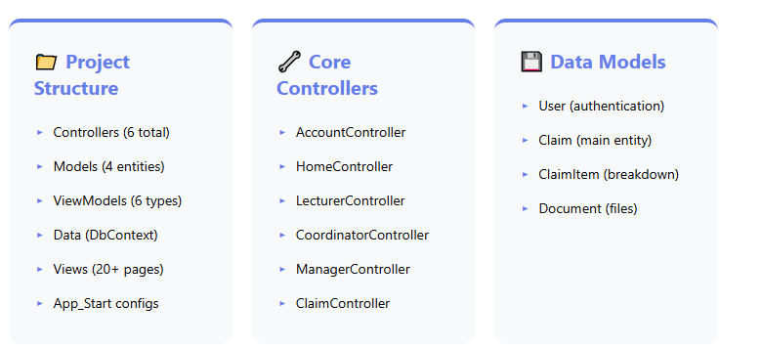
Technical Architecture & Code Structure
For reliable data access, the application makes use of Entity Framework and the ASP.NET MVC architecture. my approach separates concerns using the Repository design and follows to SOLID principles. Six controllers that handle claim administration, role-specific activities, and authentication are included in the codebase. In order to ensure loose coupling between layers, l use ViewModels for data transport. The program makes use of jQuery for client-side communication, Bootstrap 4 for a responsive user interface, and Forms Authentication with role-based authorization.

Slide 6

Database Design & Security
SQL Server Implementation with Comprehensive Security

Slide 7
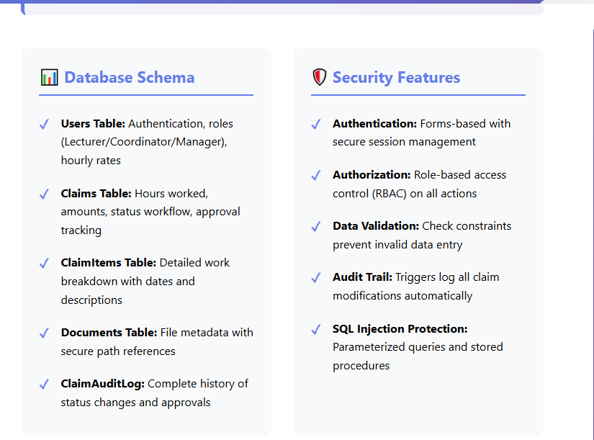

Effective delivery techniques
Referential integrity is maintained by the four core tables connected by foreign key connections in our database design, which uses a normalized schema. Authentication credentials with role-based access restriction are kept in the Users table. With status monitoring, the claims table keeps track of the entire audit trail. l used indexes for query optimization, check constraints for data validation, and cascade delete for dependent records. Password hashing, SQL injection prevention using parameterized queries, and comprehensive auditing that keeps track of all status changes are examples of security features.

Slide 8

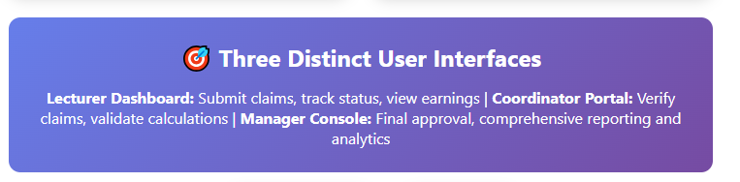
GUI Design & User Experience
For responsive design, the user interface makes use of the Bootstrap 4 framework, guaranteeing a smooth experience on desktop, tablet, and mobile devices. For consistency, l use a unified purple-blue gradient color scheme throughout the application. The design uses Font Awesome symbols for visual clarity, color-coded status badges for easy recognition, and card-based layouts for information organization. Role-specific navigation displays specific menu items according to user permissions. Smooth CSS transitions improve user interactions, while form validation offers instant feedback.

Slide 9


Core Features - Lecturer Functionality
Lecturers get access to a customized dashboard that shows extensive data, such as the overall number of claims filed, pending applications, authorized wages, and rejection history. The claim submission form automatically calculates the total amounts by multiplying the number of hours worked by the lecturer's hourly rate that is saved in their profile. Supporting documents in PDF, DOC, DOCX, and picture formats with file validation can be uploaded by lecturers. The system offers complete transparency and audit trails for all submitted claims by enabling a detailed task breakdown with unique date entries for each instruction session.

Slide 10
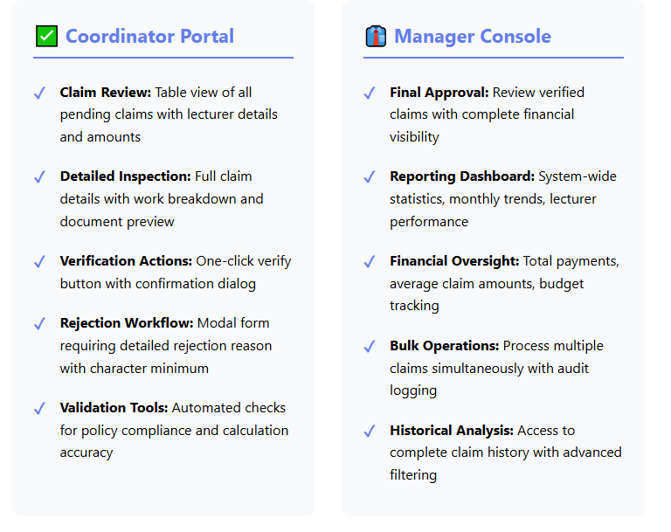
Core Features - Verification & Approval Workflow
The Coordinator function offers full claim verification capabilities, such as a detailed assessment of submitted hours, validation of supporting documentation, and comparison to established criteria. Coordinators can approve claims and move them to "Verified" status, or they can reject them and provide necessary criticism.
The Manager interface displays only validated claims that are awaiting final clearance and have complete financial oversight. Managers examine confirmed claims, have access to extensive reports with system-wide statistics, and have the final ability to approve or reject payments. Both roles provide general actions, filtering capabilities, and full audit trails for all decisions made.

Slide 11
Advanced Features & Technical Capabilities
The system uses advanced document management, including secure file upload, storage, and retrieval features. Server-side validation maintains data integrity by combining client-side jQuery validation and server-side state checks. Real-time status tracking gives you direct visibility into how a claim is progressing through the workflow. The program has a responsive design that adapts effortlessly to desktop, tablet, and mobile platforms. Session management ensures user security, and effective error handling gives user-friendly feedback for all actions. Integration with Entity Framework ensures efficient database queries

Slide 12
Database Implementation & Optimization
Three optimized stored procedures for complex queries, two database views for streamlined data access, and two triggers for automated business logic are all part of our database implementation. The sp_GetManagerReports function produces thorough analytics, the sp_GetLecturerDashboard procedure effectively aggregates claim statistics, and the sp_GetClaimsByStatus procedure filters by workflow state. Views improve efficiency and code maintainability by providing pre-joined data for frequently asked queries.

Slide 13


Conclusion & Project Success
Transforming Academic Administration Through Technology
The Contract Monthly Claim System successfully shows how contemporary online technology may be used to address practical business problems. It demonstrates excellent practices in software engineering, such as responsive design, role-based security, Entity Framework ORM, MVC pattern, and thorough validation. This project demonstrates how user-centric interface development and careful system design can significantly increase efficiency in operation while raising user satisfaction.

